Slide 1
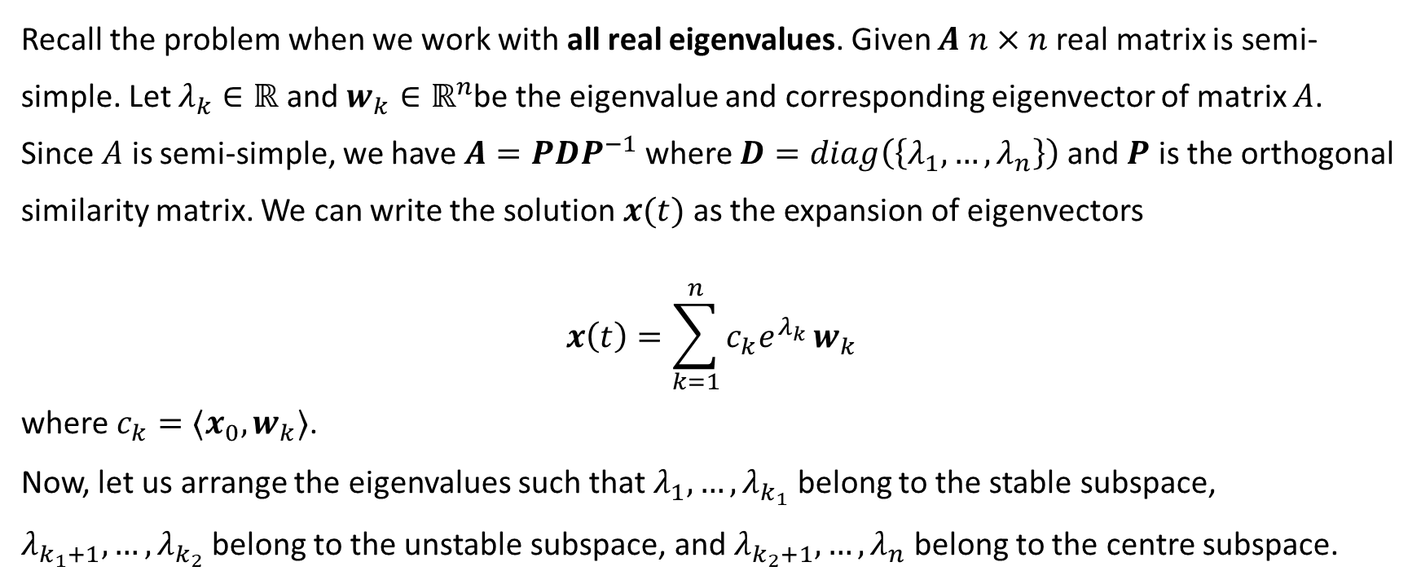
Problem Sheet 1 Q3
Recall the problem when we work with all real eigenvalues. Given $A$ $n×n$ real matrix is semi-simple. Let $λ_{k}∈ℝ$ and $w_{k}∈ℝ^{n}$be the eigenvalue and corresponding eigenvector of matrix $A$. Since $A$ is semi-simple, we have $A=PDP^{−1}$ where $D=diag\left(\left\{λ_{1},…,λ_{n}\right\}\right)$ and $P$ is the orthogonal similarity matrix. We can write the solution $x(t)$ as the expansion of eigenvectors $$x\left(t\right)=\sum_{k=1}^{n}{c_{k}e^{λ_{k}}}w_{k}$$
where $c_{k}=⟨x_{0},w_{k}⟩$.
Now, let us arrange the eigenvalues such that $λ_{1},…,λ_{k_{1}}$ belong to the stable subspace, $λ_{k_{1}+1},…,λ_{k_{2}}$ belong to the unstable subspace, and $λ_{k_{2}+1},…,λ_{n}$ belong to the centre subspace.

Slide 2
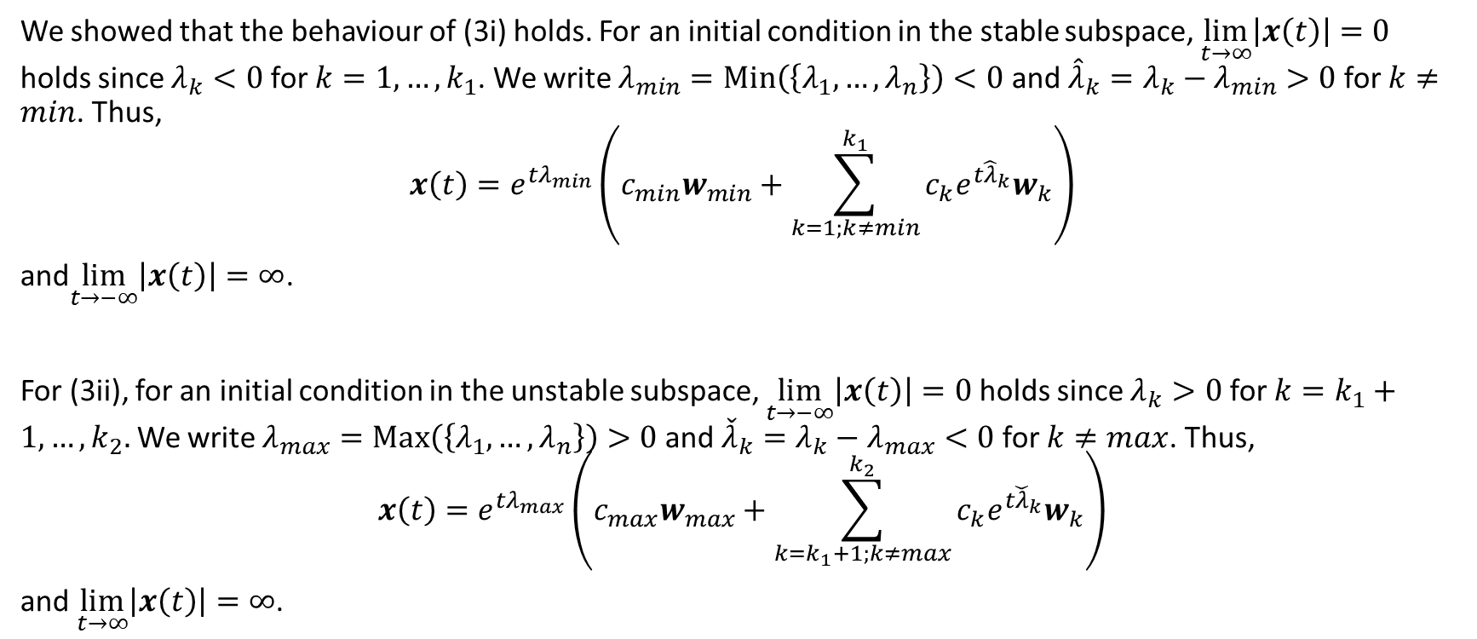
Problem Sheet 1 Q3 (continue)
We showed that the behaviour of (3i) holds. For an initial condition in the stable subspace, $\lim_{t→∞}\left|x\left(t\right)\right|=0$ holds since $λ_{k}<0$ for $k=1,…,k_{1}$. We write $λ_{min}=Min\left(\left\{λ_{1},…,λ_{n}\right\}\right)<0$ and ${\hat{λ}}_{k}=λ_{k}−λ_{min}>0$ for $k≠min$. Thus, $$x\left(t\right)=e^{{tλ}_{min}}\left(c_{min}w_{min}+\sum_{k=1;k≠min}^{k_{1}}{c_{k}e^{t{\hat{λ}}_{k}}w_{k}}\right)$$
and$\lim_{t→−∞}\left|x\left(t\right)\right|=∞$.
For (3ii), for an initial condition in the unstable subspace, $\lim_{t→−∞}\left|x\left(t\right)\right|=0$holds since $λ_{k}>0$ for $k=k_{1}+1,…,k_{2}.$We write $λ_{max}=Max\left(\left\{λ_{1},…,λ_{n}\right\}\right)>0$ and ${\check{λ}}_{k}=λ_{k}−λ_{max}<0$ for $k≠max$. Thus, $$x\left(t\right)=e^{{tλ}_{max}}\left(c_{max}w_{max}+\sum_{k=k_{1}+1;k≠max}^{k_{2}}{c_{k}e^{t{\check{λ}}_{k}}w_{k}}\right)$$
and $\lim_{t→∞}\left|x\left(t\right)\right|=∞$.

Slide 3
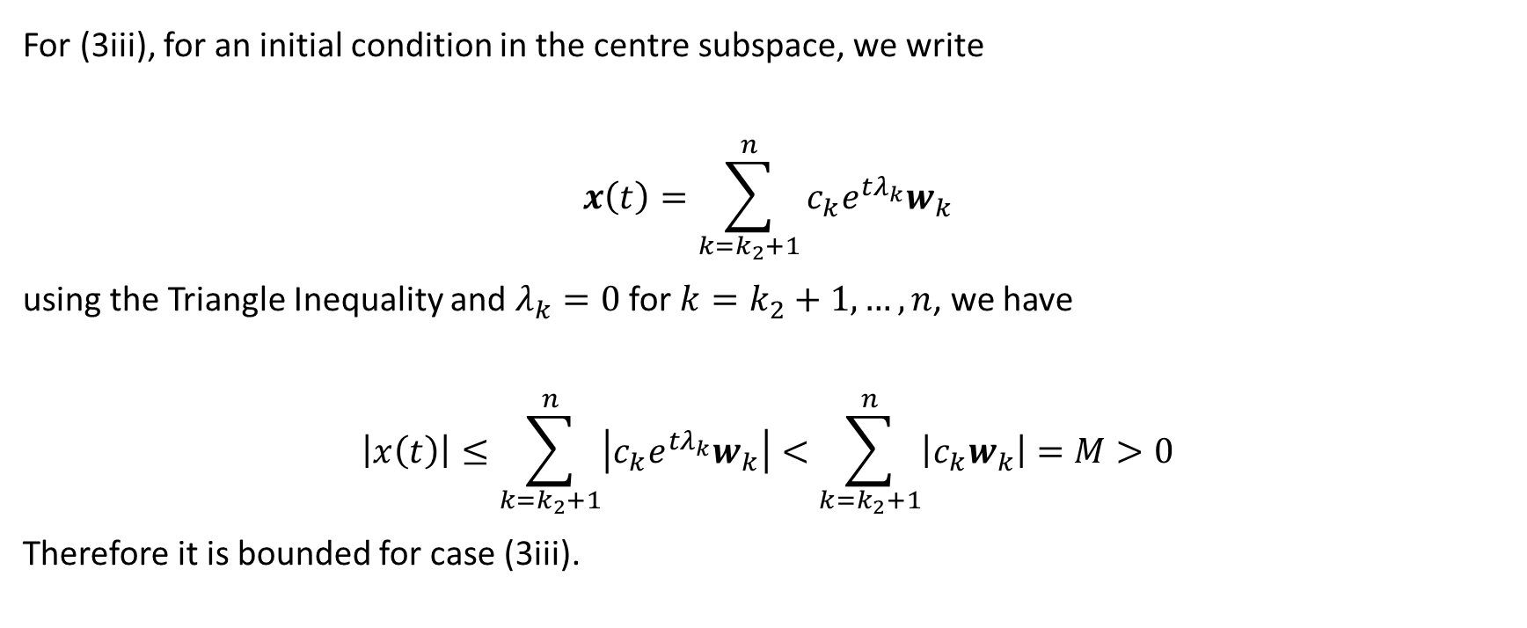
Problem Sheet 1 Q3 (continue)
For (3iii), for an initial condition in the centre subspace, we write $$x\left(t\right)=\sum_{k=k_{2}+1}^{n}{c_{k}e^{tλ_{k}}w_{k}}$$
using the Triangle Inequality and $λ_{k}=0$ for $k=k_{2}+1,…,n$, we have
$$\left|x\left(t\right)\right|≤\sum_{k=k_{2}+1}^{n}{\left|c_{k}e^{tλ_{k}}w_{k}\right|}<\sum_{k=k_{2}+1}^{n}{\left|c_{k}w_{k}\right|}=M>0$$
Therefore it is bounded for case (3iii).

Slide 4
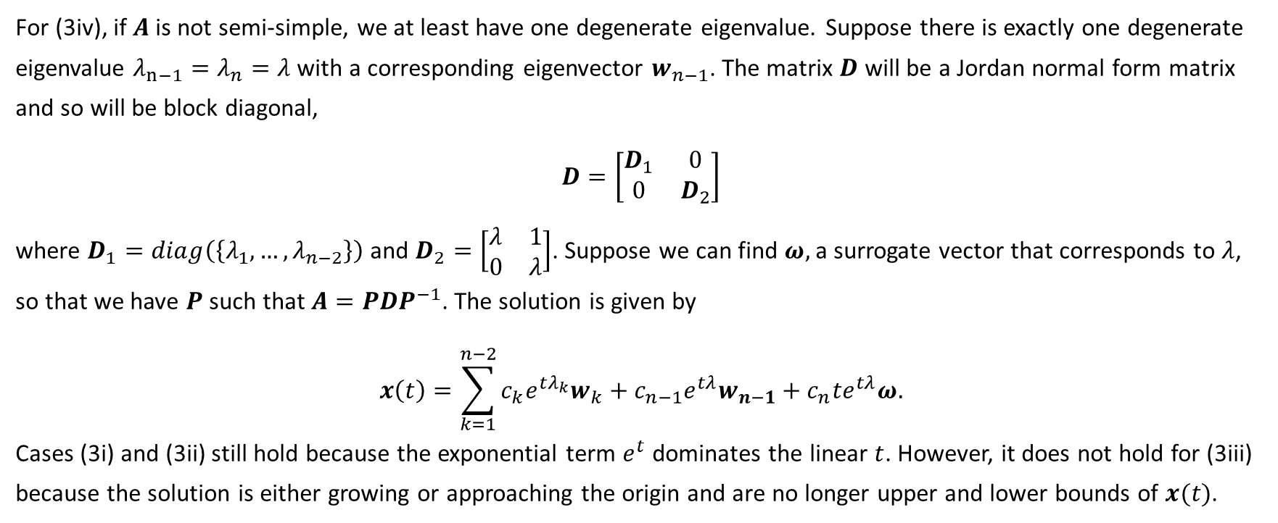
Problem Sheet 1 Q3 (continue)
For (3iv), if $A$ is not semi-simple, we at least have one degenerate eigenvalue. Suppose there is exactly one degenerate eigenvalue $λ_{n−1}=λ_{n}=λ$ with a corresponding eigenvector $w_{n−1}$. The matrix $D$ will be a Jordan normal form matrix and so will be block diagonal,
$$D=\left[\begin{matrix}D_{1} & 0 \\ 0 & D_{2}\end{matrix}\right]$$
where $D_{1}=diag\left(\left\{λ_{1},…,λ_{n−2}\right\}\right)$ and $D_{2}=\left[\begin{matrix}λ & 1 \\ 0 & λ\end{matrix}\right]$. Suppose we can find $ω,$a surrogate vector that corresponds to $λ$, so that we have $P$ such that $A=PDP^{−1}$. The solution is given by $$x\left(t\right)=\sum_{k=1}^{n−2}{c_{k}e^{tλ_{k}}w_{k}}+c_{n−1}e^{tλ}w_{n−1}+c_{n}te^{tλ}ω.$$
Cases (3i) and (3ii) still hold because the exponential term $e^{t}$ dominates the linear $t$. However, it does not hold for (3iii) because the solution is either growing or approaching the origin and are no longer upper and lower bounds of $x(t)$.

Slide 5
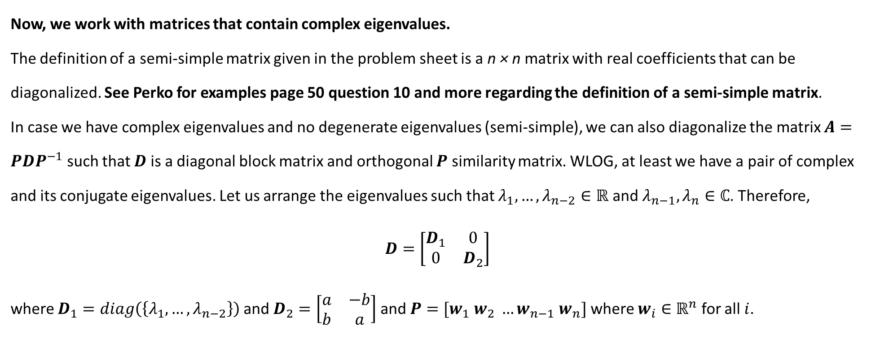
Problem Sheet 1 Q3 (continue)
Now, we work with matrices that contain complex eigenvalues.
The definition of a semi-simple matrix given in the problem sheet is a n × n matrix with real coefficients that can be diagonalized. See Perko for examples page 50 question 10 and more regarding the definition of a semi-simple matrix.
In case we have complex eigenvalues and no degenerate eigenvalues (semi-simple), we can also diagonalize the matrix $A=PDP^{−1}$ such that $D$ is a diagonal block matrix and orthogonal $P$ similarity matrix. WLOG, at least we have a pair of complex and its conjugate eigenvalues. Let us arrange the eigenvalues such that $λ_{1},…,λ_{n−2}∈ℝ$ and $λ_{n−1}, λ_{n}∈ℂ$. Therefore,
$$D=\left[\begin{matrix}D_{1} & 0 \\ 0 & D_{2}\end{matrix}\right]$$
where $D_{1}=diag\left(\left\{λ_{1},…,λ_{n−2}\right\}\right)$ and $D_{2}=\left[\begin{matrix}a & −b \\ b & a\end{matrix}\right]$ and $P=[w_{1} w_{2} …w_{n−1} w_{n}]$ where $w_{i}∈ℝ^{n}$ for all $i$.

Slide 6
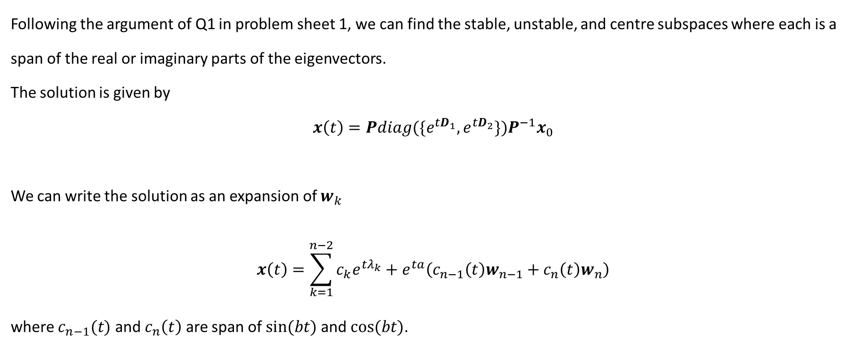
Problem Sheet 1 Q3 (continue)
Following the argument of Q1 in problem sheet 1, we can find the stable, unstable, and centre subspaces where each is a span of the real or imaginary parts of the eigenvectors.
The solution is given by $$x\left(t\right)={Pdiag(\{e}^{tD_{1}},e^{tD_{2}}\})P^{−1}x_{0}$$
We can write the solution as an expansion of $w_{k}$
$$x\left(t\right)=\sum_{k=1}^{n−2}{c_{k}e^{tλ_{k}}}+e^{ta}\left(c_{n−1}\left(t\right)w_{n−1}+c_{n}\left(t\right)w_{n}\right)$$
where $c_{n−1}(t)$ and $c_{n}\left(t\right)$ are span of $sin⁡(bt)$and $cos⁡(bt)$.

